Slide 1

Python Web App Hosted with AWS ECS
EPAM University Program 2020
ZHUK ROMAN

Slide 2
Agenda
Create application.
Dockerize my app.
Use Jenkins for creating docker image on every push.
Host app with Amazon Web Services (ECS, RDS, S3, ELB, Auto Scaling).

Slide 3




Links
zhuk-roman/tabs
http://app.mit.pp.ua/

Slide 4
Building Application
It will be a simple bookmark application.
App will allow users to:
Register and login to account
Create new bookmarks and modify existing ones
View list of bookmarks
App will use AWS RDS with MYSQL 8 database, AWS S3 bucket to store downloaded favicons of websites and AWS ECS to host app inside containers.

Slide 5

Python Packages
Flask is a micro web framework written in Python. It is classified as a microframework. It has no database abstraction layer, form validation, or any other components where pre-existing third-party libraries provide common functions. However, Flask supports extensions that can add application features as if they were implemented in Flask itself.
Boto3 is the Amazon Web Services (AWS) SDK for Python. It enables Python developers to create, configure, and manage AWS services, such as EC2 and S3.
Flask-SQLAlchemy is an extension for Flask that adds support for SQLAlchemy.
Flask-Login provides user session management for Flask. It handles the common tasks of logging in, logging out, and remembering users sessions.
Flask-Bcrypt is a Flask extension that provides bcrypt hashing utilities.
Flask-WTF is a simple integration of WTForms for Flask.
Also following packages were used: requests, os, favicon, random, datetime, bs4.

Slide 6
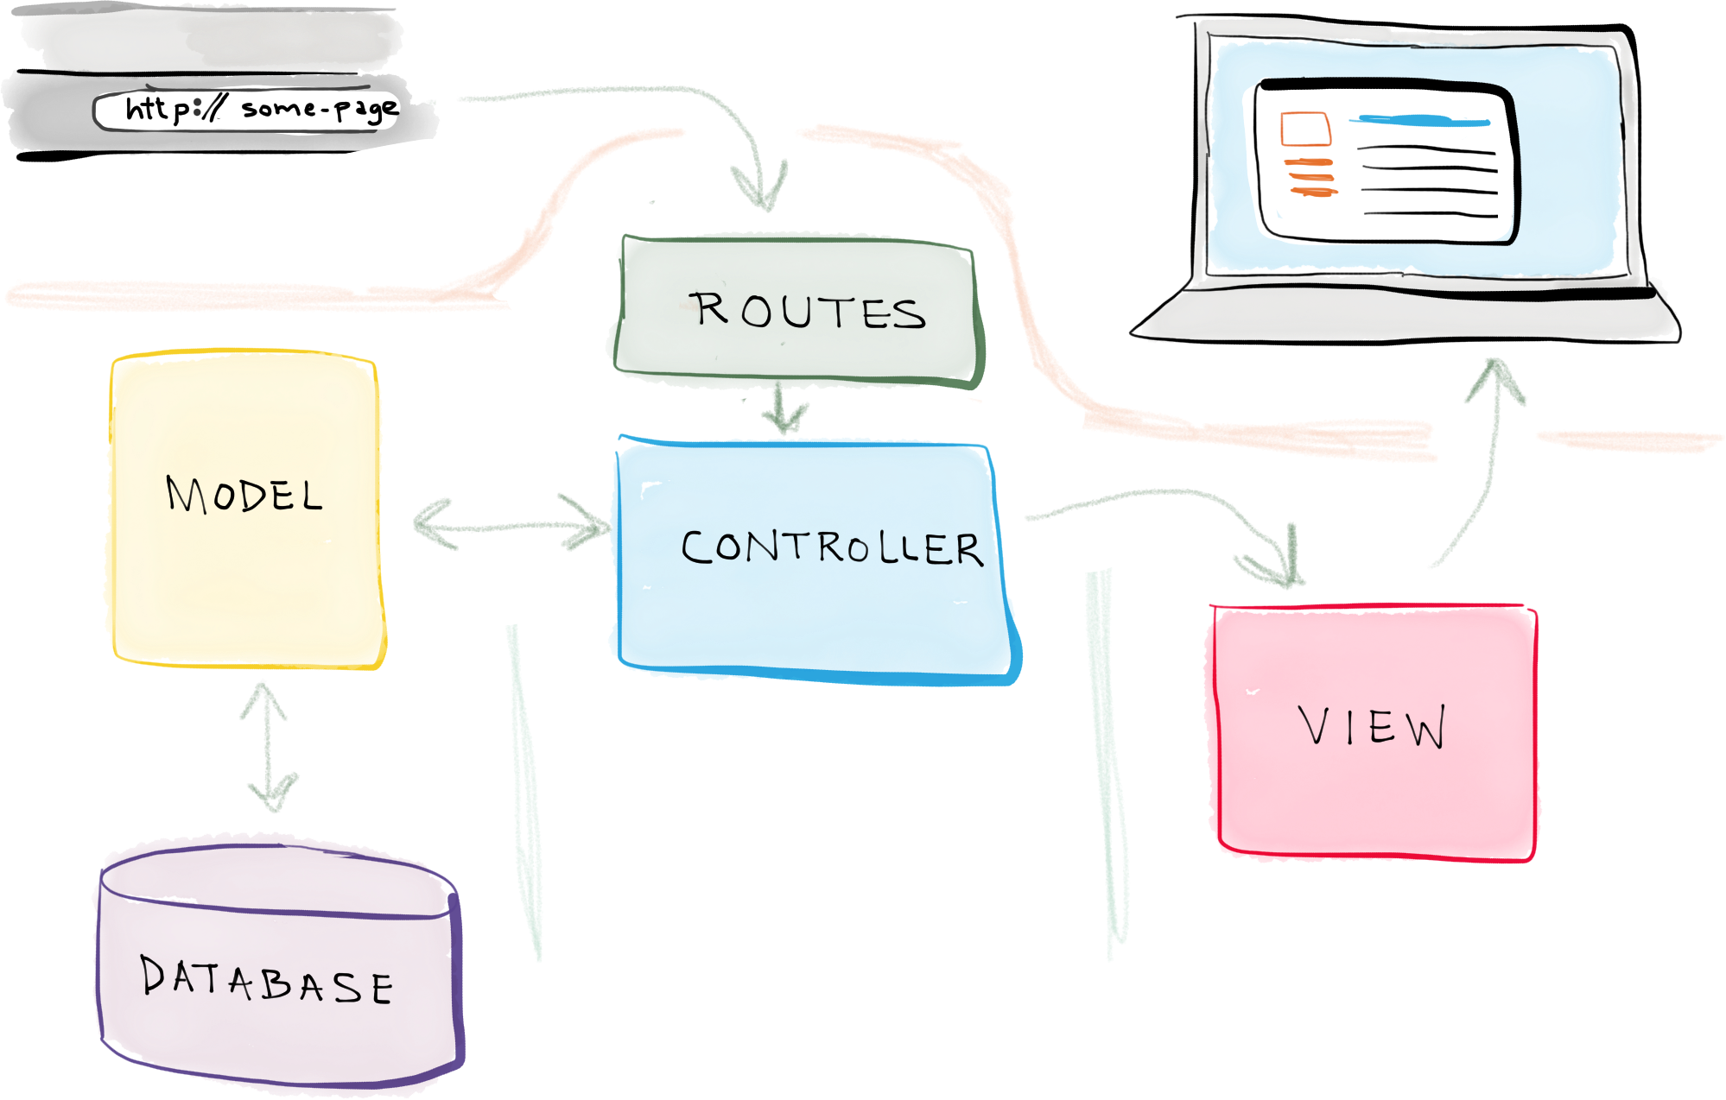
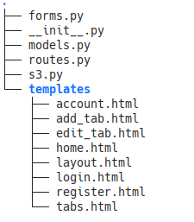
MVC

Slide 7
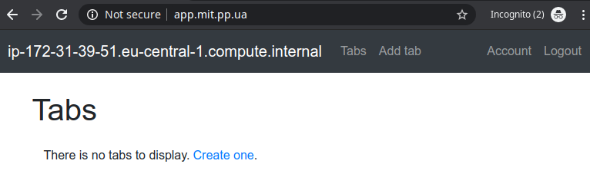
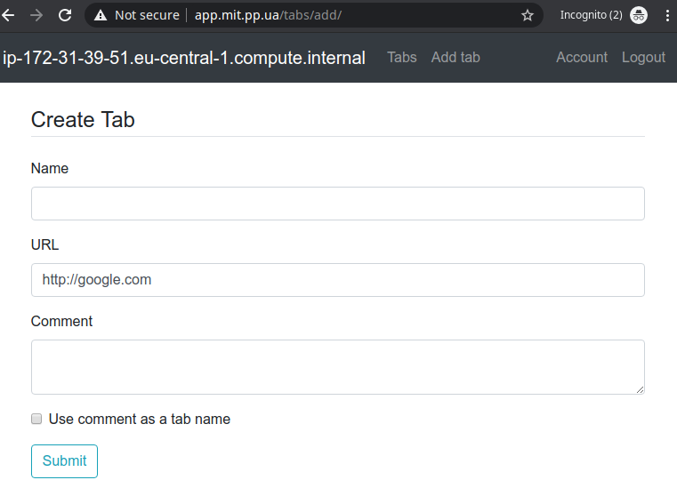
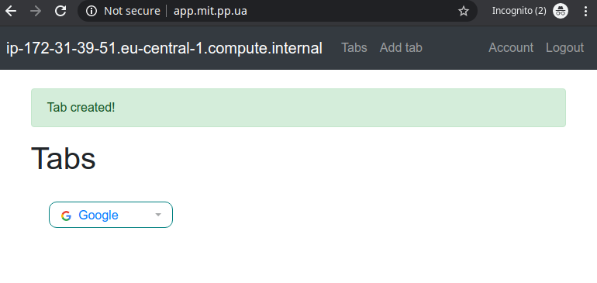
Working App
2
1
3

Slide 8
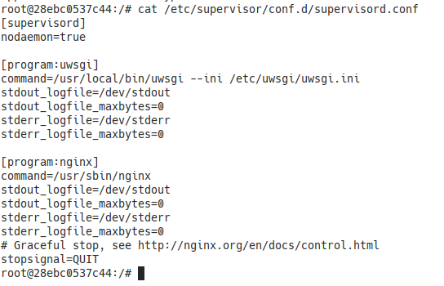
Dockerizing
Initial docker image is tiangolo/uwsgi-nginx-flask-docker
It is an image with uWSGI and Nginx for
Flask applications in Python
running in a single container.
The combination of uWSGI with Nginx is
a common way to deploy Python Flask
web applications.
It is widely used in the industry and would provide decent performance.

Slide 9
Dockerfile
FROM tiangolo/uwsgi-nginx-flask:python3.7
WORKDIR /root
RUN curl "https://awscli.amazonaws.com/awscli-exe-linux-x86_64.zip" -o "awscliv2.zip" && \
unzip awscliv2.zip && \
./aws/install && \
rm -rf awscliv2.zip aws/
COPY ./.aws /root/.aws
COPY ./aws_credentials /root/.aws/credentials
WORKDIR /app
COPY requirements.txt uwsgi.ini /app/
COPY tabs /app/tabs
COPY static /app/static
RUN pip install --upgrade pip && \
pip install -r requirements.txt
EXPOSE 80

Slide 10
AWS Infrastructure
Terraform scenario was written for creating Aws infrastructure. Following components are managed with terraform:
ECS cluster
ECS service
ECS task definition
ECS auto scaling policies
ECS auto scaling target
CloudWatch alarms for scale in and scale out
RDS, S3, ELB, IAM users and policies were created manually.

Slide 11
Jenkins
Jenkins pipeline will build a docker image and push it to private repository on dockerhub.
AWS credentials with permissions to upload and delete S3 files are stored in Jenkins secretfile credentials. It will be added to our docker image.
Last step in pipeline is force ECS to pull latest image and deploy to all instances in ECS service.

Slide 12
Jenkins Pipeline
environment {...}
stages {
stage('Cloning git') {...}
stage('Copy aws credentials') {
steps{
script {
withCredentials([file(credentialsId: 'aws_credentials', variable: 'aws_credentials')]) {
sh "cp \$aws_credentials aws_credentials"}
}
}
}
stage('Building image') {...}
stage('Push image'){...}
stage('Remove unused docker image and sensitive data') {...}
stage('ECS force new deployment') {
steps{
sh "aws ecs update-service --cluster white-hart --service tabs --force-new-deployment"
}
}
}
}

Slide 13
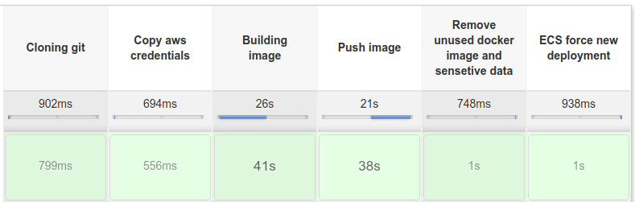
Jenkins
In order to get this pipeline work we will have to install docker and aws-cli to the machine where Jenkins is installed.
Jenkins user should be added to docker group. Aws user should have permission to perform UpdateService call for ECS service.

Slide 14












Architecture Design
Github
Jenkins
Terraform
IAM
RDS
Users
Elastic Load Balancer
Scaling Group
ECS
IAM
S3 Bucket

Slide 15

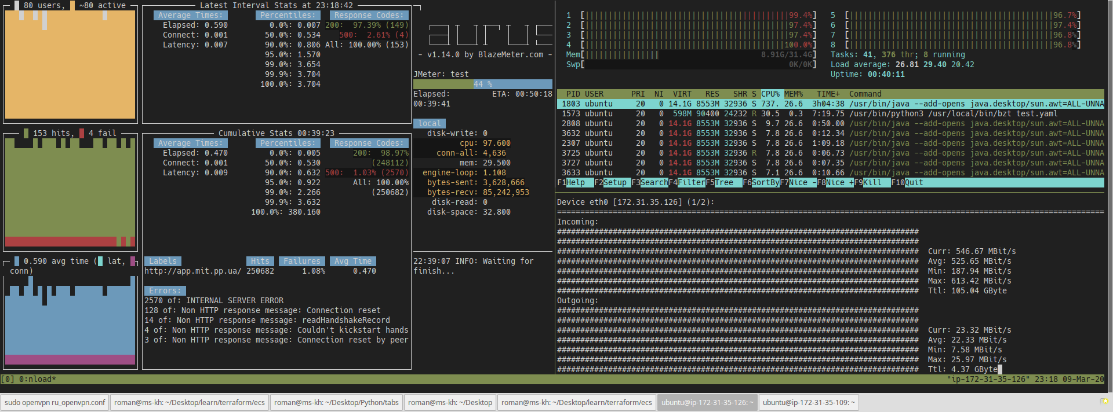
Load Test

Slide 16
Taurus Script
execution:
- scenario: test
concurrency: 80
ramp-up: 30m
hold-for: 60m
scenarios:
test:
requests:
- http://app.mit.pp.ua/
cookies:
- name: remember_token
value: 1|a3b8cf9671d622.......
domain: app.mit.pp.ua
- name: session
value: .eJwlj0tqAzEQBe-itRfqlrpb8mUG....
domain: app.mit.pp.ua

Slide 17
Load Test Metrics

Slide 18
Autoscale Event Messages
In event log of the ECS service we can see notifications when CloudWatch alarm triggers autoscale policy.

Slide 19
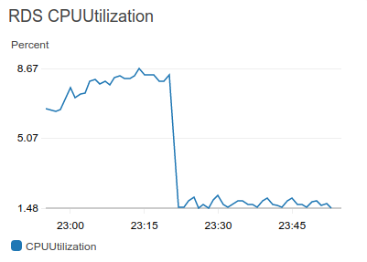
Load Test Metrics
During the test RDS metrics was ok.
The highest RDS metric was CPU utilization.
It is clear from test that app can work stable
with about 10k visit/minute (2 request per visit)
using 9 ECS tasks(0.25 vcpu, 512 mb RAM each).

Slide 20
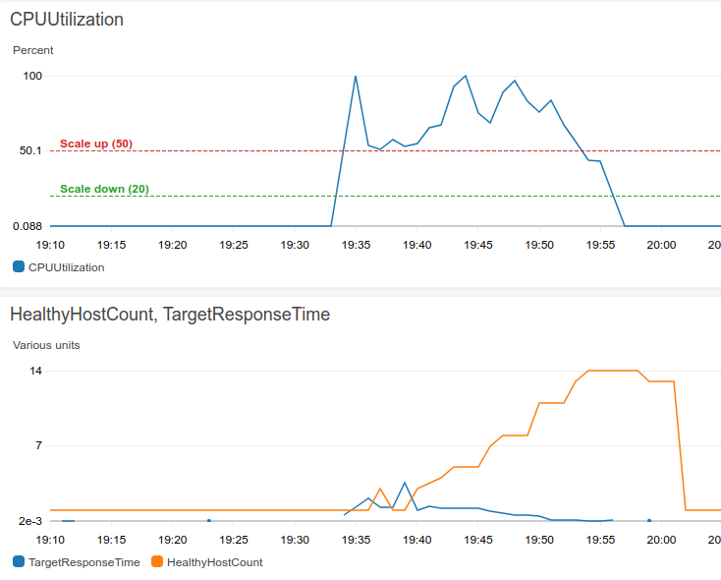
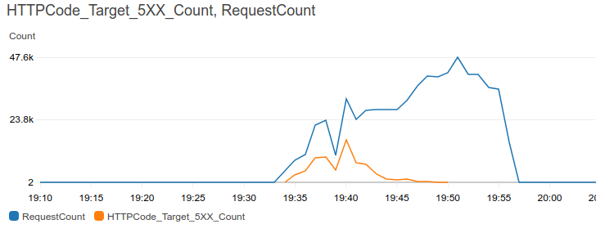
More Aggressive Test

Slide 21
Thank You!
My contacts
t.me/zhuk_roman
zhuk.roman.v@gmail.com

